Slide 1
Reverse engineering project
Created by kYLE parker and kOA hAWN
DUE THURSDAY, JUNE 11, 2026
COMP 4723 – Ethical hacking
Notes:
Greeting + introduce self Took intentionally vulnerable/pseudo malicious program and analyzed it for issues using static and dynamic techniques: Ghidra, binwalk, radare2, ltrace, strace, and gdb.

Slide 2
Scope & Objective
Recreate program’s logic/source code
Detect vulnerabilities and dangerous code
Create mitigations and demonstrate proof-of-concept exploit
Notes:
~45 sec
First, we needed to understand what the program is and what it does. Then we need to figure out how it does things.
From there, we can analyze places that are vulnerable, malicious, or poor quality. This could includes buffer overflows, lack of validation, and privilege escalation.
We will conclude with code that patches or removes the vulnerable/malicious codes.

Slide 3
Tools used
Binwalk
No signs of encryption or obsecrated code (low entropy)
Ghidra
Disassembly, extract call graph, libc symbols, 5 orphaned functions
GDB
Inspect and run hidden functions, confirm crashes
Ltrace/strace
Dynamic tracing, identified three commands for the shell
Notes:
~1 min
We used a total of 6 tools, but primarily engaged with binwalk, ghidra, GDB, ltrace, and strace.
binwalk was used to determine program sections, offsets, and calculated the program’s entropy. This will be discussed on the next slide.
Ghidra was used to disassemble the program, create a call graph, see which standard library functions were called, and exposed 5 orphaned functions. Some code and function call graphs will be discussed.
The last major tool we used was GDB for dynamic debugging which allowed us to easily call the orphaned functions.
Ltrace and strace were used in the preliminary stages to clearly show the program’s flow, system/lib calls, and understand what inputs are valid.
Radare2 was briefly used, but is much more involved. Nothing new was found from using radare2, so results are omitted.
We took the static/dynamic approach since simply statically or dynamically analyzing this program would result in an incomplete analysis.
Static analysis shows us what could be executed and thus provide insight into potential behavior. Dynamic analysis shows us what does in fact occur.

Slide 4
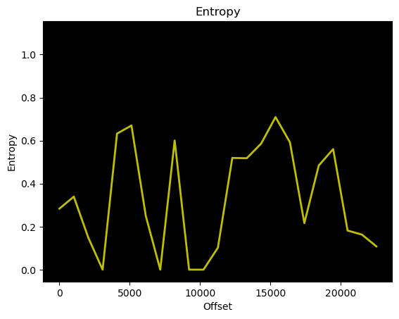
Binwalk results
radare2
DECIMAL HEXADECIMAL ENTROPY
--------------------------------------------------------------------------------
0 0x0 Falling entropy edge (0.283684)
__________________________________________________________________
Scan Time: 2026-05-29 10:47:25
Target File: target
MD5 Checksum: 8b5eec08f0106f2d814b5706abd8675f
Signatures: 436
DECIMAL HEXADECIMAL DESCRIPTION
--------------------------------------------------------------------------------
0 0x0 ELF, 64-bit LSB shared object, AMD x86-64, version 1 (SYSV)
14784 0x39C0 ESP Image (ESP32): segment count: 8, flash mode: QUIO, flash speed: 40MHz, flash size: 1MB, entry address: 0x4500660d, hash: none
17156 0x4304 Unix path: /
Notes:
~ 45 sec
On the right, we see the entropy graph spikes at the approximate program offsets. This is expected, so it is not considered significant.
In the center of the screen, the falling entropy edge is 0.283684 which shows the entropy is very low indicating a plain-text simple program (not a lot of randomness, nor encryption.) This makes it very easy to practice reverse engineering.
On the bottom, the program’s checksum, and sectors are provided.
We care about the ELF section, which is the executable. This shows it is an AMD x86-64 program which means it requires a 64-bit non-ARM machine to run on.
For this analysis, the ESP image is ignored since it would only be used for possibly running on a microprocessor. As such, we only care about the ELF image.

Slide 5
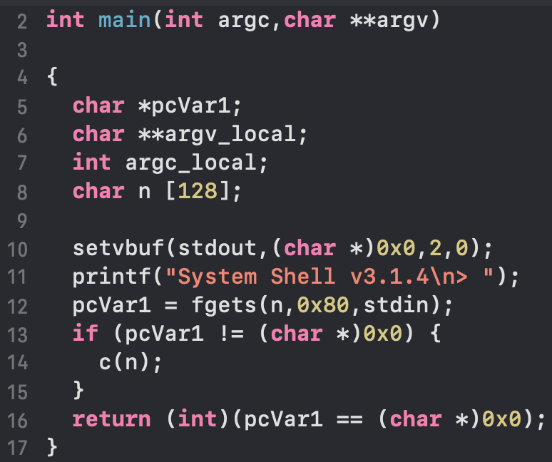
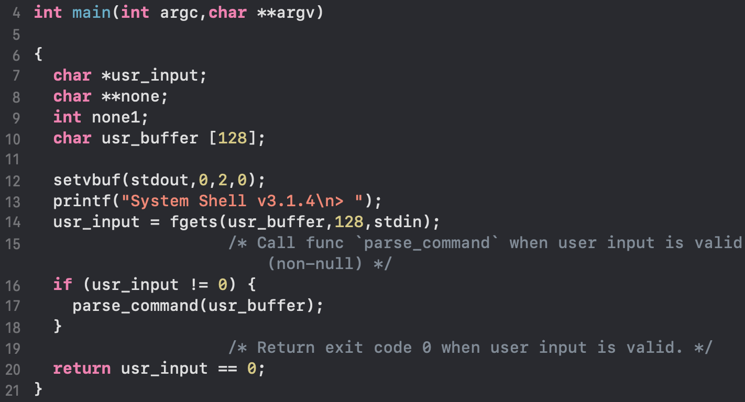
Ghidra
Generated C code from the program’s binary
Resolved function calls (system and user-defined)
Revealed 5 unreferenced functions
Saved a lot of manual work
Notes:
~ 40 sec
Action: Used Ghidra to decompile the binary and generate C from assembly.
Results
Produced readable C output for main (screenshot shows raw decompiled main before and after variable renaming).
Resolved system and program calls, converting many call sites to named functions.
Recovered/renamed numerous functions (originally single-character or autogenerated names).
Identified 5 unreferenced functions (possible dead code or library leftovers).
Significantly reduced manual analysis effort by automating call-resolution and decomplication.

Slide 6
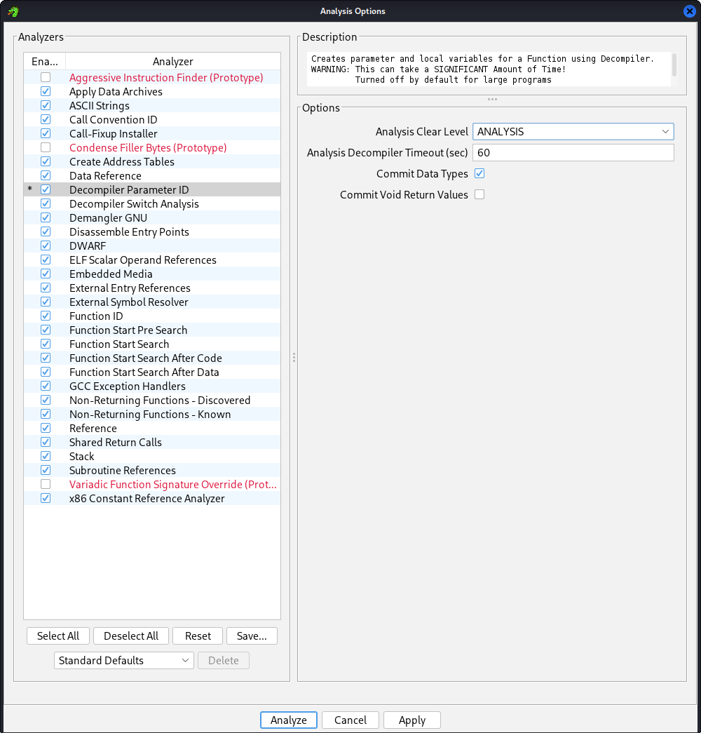
Ghidra Config
Notes:
~ 10 sec
The follow are the most useful options.
Decompiler Param/Local Recovery — reconstructs function parameters and local variables so the decompiler produces readable C prototypes and local names instead of raw registers/stack offsets.
Call Convention & Function ID — identifies calling conventions and matches known library/syscall functions so calls are shown with correct prototypes and recognizable names rather than opaque call sites.
Data/String Analyzers & Reference Recovery — finds embedded strings, constants, and cross-references, which quickly reveals I/O, file paths, protocol handlers, and where code uses those data items.

Slide 7
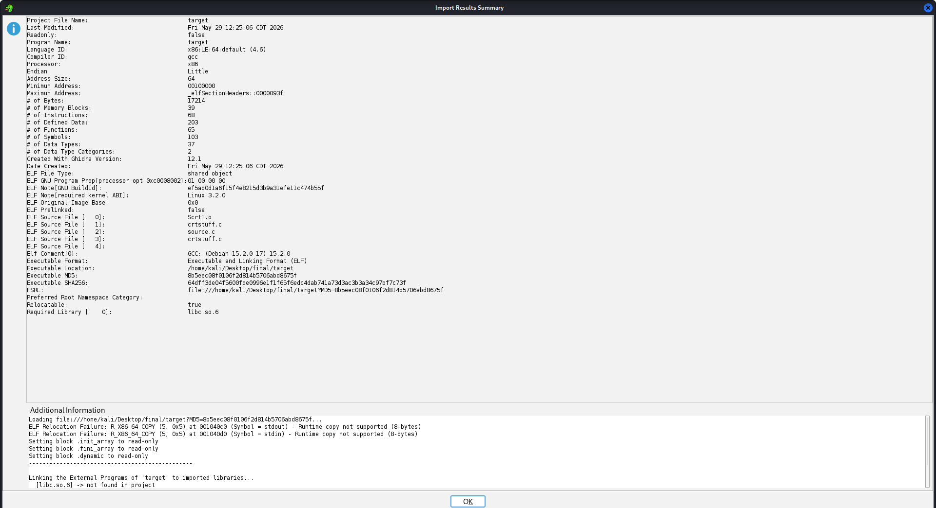
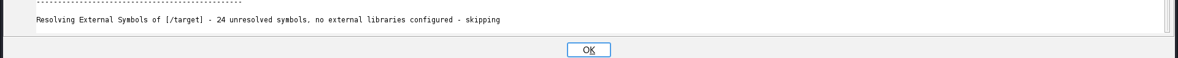
Ghidra Import summary
Notes:
5 – 10 sec
This is the summary from importing the program into Ghidra.
We found the program uses c library shared object version 6.

Slide 8
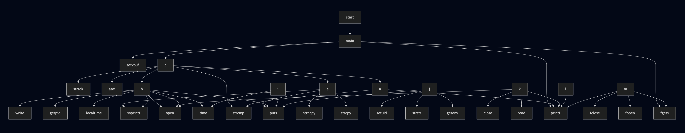
Ghidra (DETAILED Graphs)
Notes:
5-10 sec
This shows the call graph extracted from Ghidra including system calls. This version is before all provided function names were renamed to what they do.
This specific graph also shows system calls. While this is not a typical to include system calls, we thought it would be good to see which functions are used the most. Additionally, it would indicate which functions could have vulnerabilities without looking at the code directly.

Slide 9
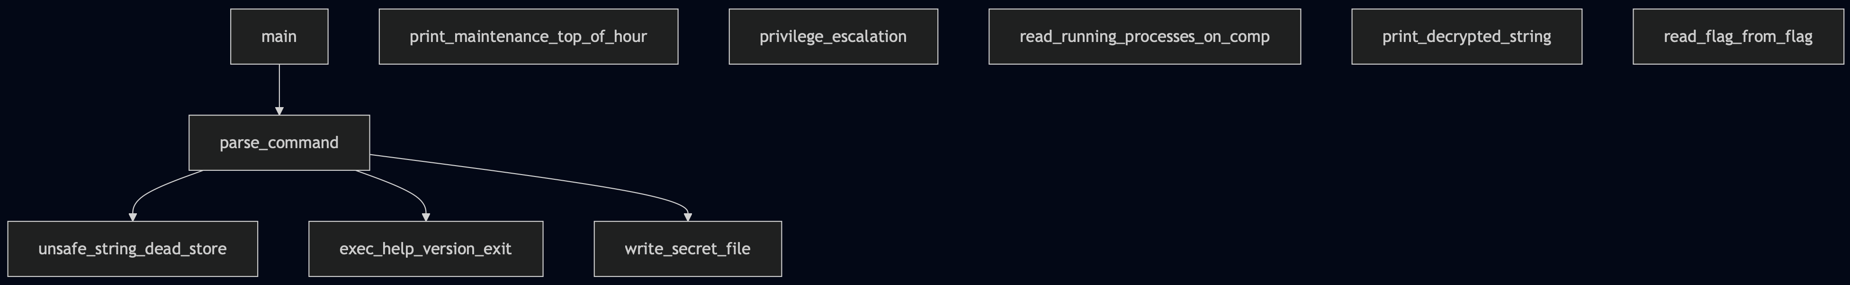
Ghidra (call graph)
Notes:
5 – 10 sec
This call graph shows user-defined functions clearing showing 5 orphaned functions.
It identifies which functions need to called and in what order. There are 5 functions (illustrated as disconnected nodes) which were called with gdb.
Nothing is possibly dangerous from the look of this call graph. However, it does lead to closer investigation of the 5 functions to see if they are implicitly called with malicious intentions.

Slide 10


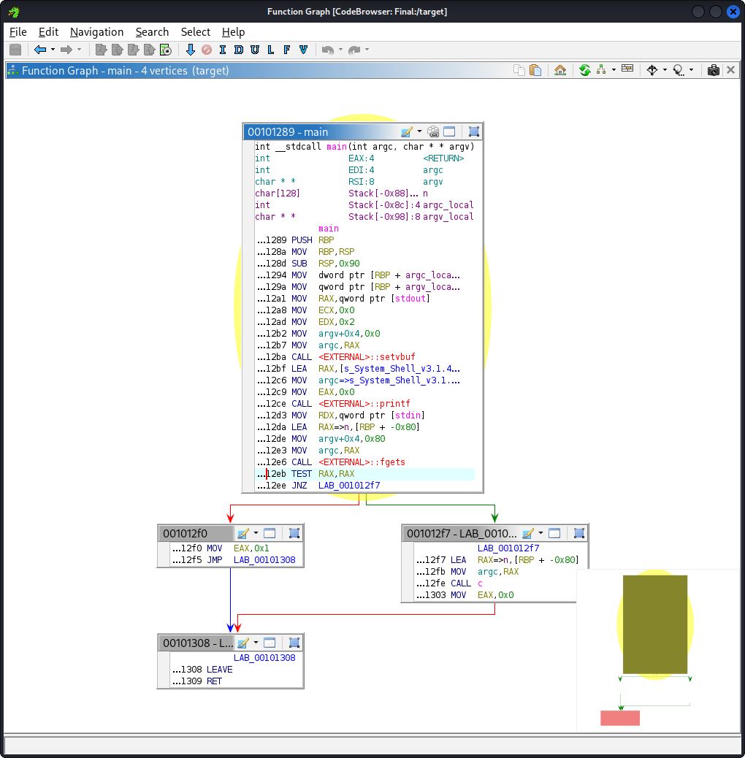
Ghidra (ASM Main call graph)
Notes:
5 – 10 sec
This graph was generated by Ghidra and shows main in Assembly rather than C. This graph is intended to complement the other ones, but shows the raw program.

Slide 11
Ltrace results
setvbuf(0x7f80131b05c0, nil, 2, 0) = 0
printf("System Shell v3.1.4\n> ") = 22
fgets(Hello
"Hello\n", 128, 0x7f80131af8e0) = 0x7fff11e826c0
strtok("Hello\n", " \n") = "Hello"
strcmp("Hello", "run") = -42
strcmp("Hello", "cmd") = -27
strcmp("Hello", "secret") = -43
+++ exited (status 0) +++
Shows library functions called
Input after printf call was “Hello”
Notes:
~ 30 sec
Here, we start the program then wait to be prompted. Once ready, we type “Hello” followed by the return key. This will send the literal string “Hello\n”.
Then it shows the fgets call and which calls are made from there. It helps trace a presumed-incorrect input. As we can see, strtok and 3 strcmp functions are called.
The strcmp calls leaks the valid command: run, cmd, and secret.
Finally, the program exits with code 0, so nothing went wrong even through nothing happened.

Slide 12
Strace results
execve("./target", ["./target"], 0x7fff7300f420 /* 57 vars */) = 0
brk(NULL) = 0x55f5fbe0c000
mmap(NULL, 8192, PROT_READ|PROT_WRITE, MAP_PRIVATE|MAP_ANONYMOUS, -1, 0) = 0x7ff23abb2000
access("/etc/ld.so.preload", R_OK) = -1 ENOENT (No such file or directory)
openat(AT_FDCWD, "/etc/ld.so.cache", O_RDONLY|O_CLOEXEC) = 3
fstat(3, {st_mode=S_IFREG|0644, st_size=102235, ...}) = 0
mmap(NULL, 102235, PROT_READ, MAP_PRIVATE, 3, 0) = 0x7ff23ab99000
close(3) = 0
openat(AT_FDCWD, "/usr/lib/x86_64-linux-gnu/libc.so.6", O_RDONLY|O_CLOEXEC) = 3
read(3, "\177ELF\2\1\1\3\0\0\0\0\0\0\0\0\3\0>\0\1\0\0\0000\241\2\0\0\0\0\0"..., 832) = 832
pread64(3, "\6\0\0\0\4\0\0\0@\0\0\0\0\0\0\0@\0\0\0\0\0\0\0@\0\0\0\0\0\0\0"..., 840, 64) = 840
fstat(3, {st_mode=S_IFREG|0755, st_size=2014472, ...}) = 0
pread64(3, "\6\0\0\0\4\0\0\0@\0\0\0\0\0\0\0@\0\0\0\0\0\0\0@\0\0\0\0\0\0\0"..., 840, 64) = 840
mmap(NULL, 2055760, PROT_READ, MAP_PRIVATE|MAP_DENYWRITE, 3, 0) = 0x7ff23a9a3000
mmap(0x7ff23a9cb000, 1474560, PROT_READ|PROT_EXEC, MAP_PRIVATE|MAP_FIXED|MAP_DENYWRITE, 3, 0x28000) = 0x7ff23a9cb000
mmap(0x7ff23ab33000, 339968, PROT_READ, MAP_PRIVATE|MAP_FIXED|MAP_DENYWRITE, 3, 0x190000) = 0x7ff23ab33000
Notes:
This shows all the system calls. There is nothing out of the ordinary.
No options were loaded at program entry.

Slide 13
Strace results (CONT)
mmap(0x7ff23ab86000, 24576, PROT_READ|PROT_WRITE, MAP_PRIVATE|MAP_FIXED|MAP_DENYWRITE, 3, 0x1e3000) = 0x7ff23ab86000
mmap(0x7ff23ab8c000, 52816, PROT_READ|PROT_WRITE, MAP_PRIVATE|MAP_FIXED|MAP_ANONYMOUS, -1, 0) = 0x7ff23ab8c000
close(3) = 0
mmap(NULL, 12288, PROT_READ|PROT_WRITE, MAP_PRIVATE|MAP_ANONYMOUS, -1, 0) = 0x7ff23a9a0000
arch_prctl(ARCH_SET_FS, 0x7ff23a9a0740) = 0
set_tid_address(0x7ff23a9a0a10) = 68083
set_robust_list(0x7ff23a9a0a20, 24) = 0
rseq(0x7ff23a9a0680, 0x20, 0, 0x53053053) = 0
mprotect(0x7ff23ab86000, 16384, PROT_READ) = 0
mprotect(0x55f5e4d35000, 4096, PROT_READ) = 0
mprotect(0x7ff23abf0000, 8192, PROT_READ) = 0
prlimit64(0, RLIMIT_STACK, NULL, {rlim_cur=8192*1024, rlim_max=RLIM64_INFINITY}) = 0
getrandom("\x54\x34\x60\x72\x92\xec\xb8\x8f", 8, GRND_NONBLOCK) = 8
munmap(0x7ff23ab99000, 102235) = 0
write(1, "System Shell v3.1.4\n> ", 22System Shell v3.1.4
> ) = 22
Notes:
This shows there is a lot of internal calls. it prints the shell prompt to stdout.
Not much was useful here either.

Slide 14
Strace results (CONT)
fstat(0, {st_mode=S_IFCHR|0600, st_rdev=makedev(0x88, 0), ...}) = 0
brk(NULL) = 0x55f5fbe0c000
brk(0x55f5fbe2d000) = 0x55f5fbe2d000
read(0Hello
, "Hello\n", 1024) = 6
exit_group(0) = ?
+++ exited with 0 +++
Notes:
Here, the call to read is from the function call gets. It reads up to 1024 bytes. This indicates there is a median buffer this data is stored into prior to fgets storing it in the program’s buffer.
In all, the system trace file did not provide meaningful insight to the reversal process.

Slide 15
Core functions
Function | Trigger | Action | Relevance
unsafe_string_dead_store | run <opt> <data> | Copies data to a local buffer of size 64. opt = 1 → strcpy opt = 2 → strncpy opt = 3 → snprintf | VERY HIGH Buffer overflow possible with opt 1 Possible non-null terminated with opt 2
exec_help_version_exit | cmd <sub command> | Executes help, version, or exit | NONE – these
write_secret_file | Only with debug | Writes “secret data” to /tmp/.hidden_<PID> | LOW – CRITICAL Information leak (world‑writable tmp)
privilege_escalation | Only with debug | Calls setuid(0) & prints “Root privileges granted.” | CRITICAL if binary runs with set‑uid root.
read_running_processes_on_comp | Only with debug | Dumps /proc/self/maps | LOW – HIGH Info‑leak of memory layout
Notes:
~ 1 min
Summarize table able

Slide 16
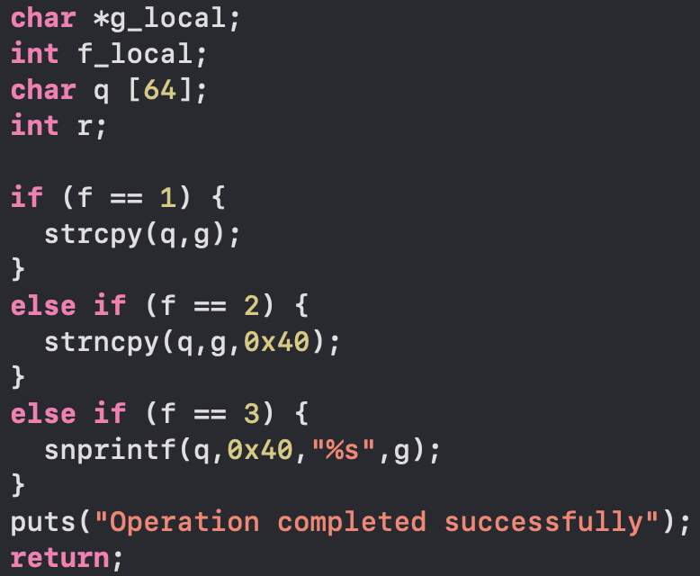
Buffer overflow potentials
f == 1 and g longer than 64 bytes, a crash will occur
f == 2 could lead to an unterminated string, becoming an array of chars
Notes:
Under case f == 1, strcpy will unconditionally copy the contents of g into q. This shows that return addresses can be overwritten and other variable may be written. This means a different function could be executed and leak data. Many times, the program will be terminated by attempting to write at q’s 65th index.
In the second case, there could be an array of chars, not a string (terminating null char acter missing).

Slide 17
Additional Findings
write_secret_file: Maintenance mode printed “Midnight maintenance mode active” only on Sundays 03:00‑03:59
print_decrypted_string: key is hardcoded, 85 is exposed and clearly shown
read_flag_from_file: Simply tries to open /flag.txt
read_running_processes_on_comp: Leaks memory map (screenshot next page)

Slide 18
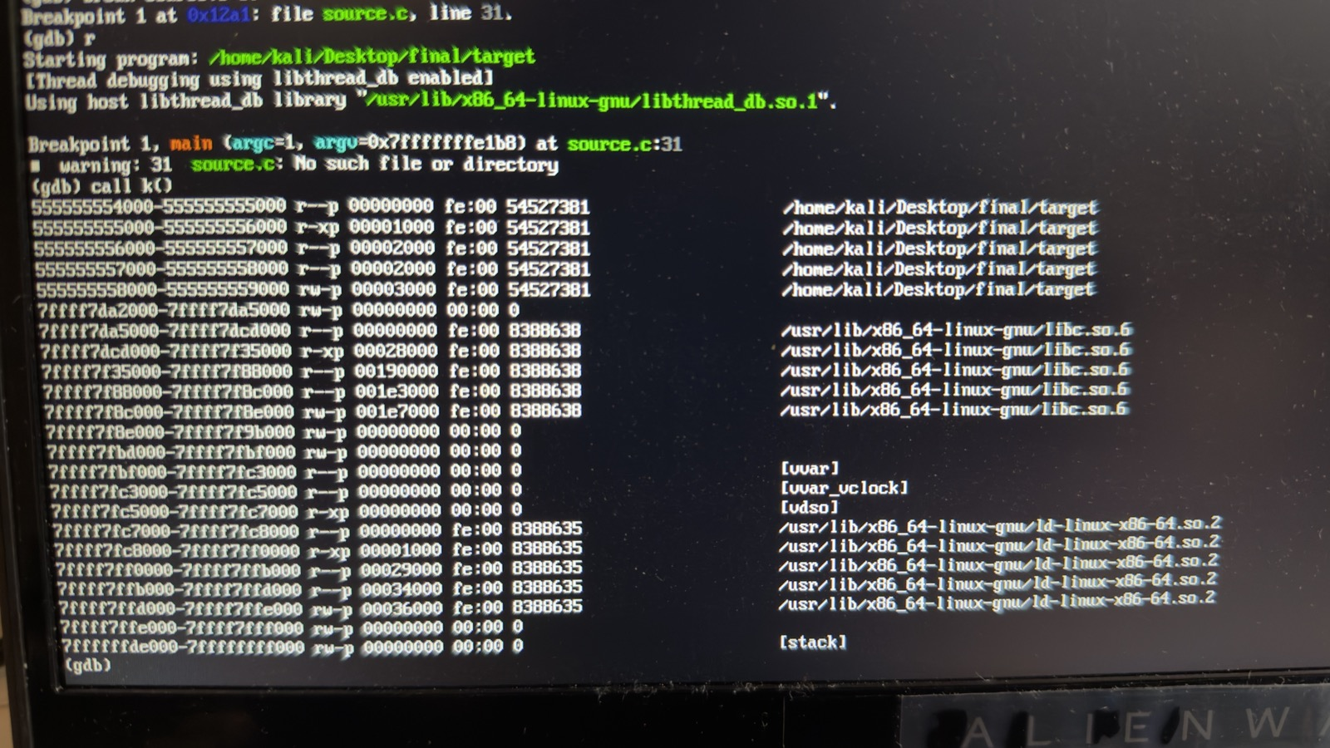
Additional findings (cont)
Notes:
As the screenshot shows, calling func k, renamed to read_running_processes_on_comp, the memory map of the device is printed. This could be used by the program to attempt read access to critical programs running.
While it is not dangerous to print the /proc/self/maps pseudo file, the ability for a malicious app to write in unguarded apps or platforms could be high.

Slide 19
Security Mitigations
Strcpy instances must be updated with snprintf or strncpy and a null char insert.
unsafe_string_dead_store: strcpy(target,string); → snprintf(target, sizeof(target), “%s”, string);
Strncpy calls must explicitly write a null char to the end.
No input validation is done with atoi, validation must occur or migration to C++ to use strtol.
Change written files to a protected folder, not /tmp
Harden the binary to ensure better security from the ground-up.
Notes:
1. Replace the unsafe strcpy
“The run 1 path copies the user string with strcpy, which ignores the destination size. The quick, safe fix is to use a bounded function. For example:
snprintf(buf, sizeof(buf), "%s", user_input);
snprintf guarantees that no more than sizeof(buf)‑1 bytes are written and always NUL‑terminates the buffer.”
2. Ensure strncpy always NUL‑terminates
“Option 2 uses strncpy, but if the source is longer than the buffer the terminator is omitted. After the call we should force it:
strncpy(buf, user_input, sizeof(buf));buf[sizeof(buf)-1] = '\0';
This preserves the intended length check while keeping the string well‑formed.”
3. Validate numeric arguments before atoi
“run expects a numeric option (1, 2, or 3). Currently it calls atoi directly, which returns 0 on any non‑numeric input and can lead to undefined branches. Replace it with strtol() and check the end‑pointer and range errors before using the value.”
4. Write secret data to a safe location
“write_secret_file currently writes to /tmp/.hidden_<PID>, a directory world‑writable. A better practice is to use a per‑user, permission‑restricted path, e.g., $HOME/.local/secret_data. This prevents other users on the system from reading or overwriting the file.”
Harden the binary at compile‑time
“Enable the compiler’s built‑in protections:
bash
gcc -Wall -Wextra -fstack-protector-strong -D_FORTIFY_SOURCE=2 \ -pie -Wl,-z,relro,-z,now -o target source.c
-fstack-protector-strongThe compiler inserts a stack canary (a random guard value) between a function’s local variables and the saved return address. At function exit the canary is checked; if it has changed the program aborts (usually with __stack_chk_fail).Overwrites of local buffers (e.g., a strcpy overflow) will also overwrite the canary. The mismatch is detected before the corrupted return address is used, preventing classic control‑flow hijacks.
-D_FORTIFY_SOURCE=2This macro activates additional runtime checks for a set of libc functions that deal with buffers (strcpy, strncpy, memcpy, sprintf, etc.). When the compiler can determine the size of the destination at compile time, it replaces the call with a built‑in version that validates the length and aborts on overflow. Level 2 applies the checks even when only partial size information is available.It catches many obvious overflows before they reach the vulnerable library routine, turning a silent memory corruption into an immediate abort.
-pieBuilds the executable as a Position‑Independent Executable. All code addresses are calculated relative to a load address that the loader chooses at runtime.An attacker can’t rely on fixed addresses for gadgets or function pointers, because the base address changes each execution (ASLR).
-Wl,-z,relro,-z,now (passed to the linker)RELRO = Read‑Only Relocations.
-z,relro makes the Global Offset Table (GOT) and other relocation sections read‑only after the dynamic loader resolves them.
-z,now forces immediate resolution of all PLT/GOT entries rather than lazy (on‑first‑use) binding.A GOT overwrite—a classic technique to redirect control flow to attacker‑controlled code—fails because the GOT pages are marked read‑only before the program ever runs. Immediate binding also removes the window where an attacker could race to overwrite a lazy‑resolved entry.

